Slide 1
Meng Group Project
Edward Porter, Martin Lewis Wynne-Jones, David George, Tendai Ngoni and Miguel Santos

Slide 2
Task
Create a fan clock with wireless communication that can display an user inputted message

Slide 3
Methods for success
Task delegation to smaller groups of people to allow for more efficient time and resource management.
Working as a cohesive team for designing and brainstorming sessions
Split up for parts gathering and assembly
Keeping to schedules as well as trying to keep as far ahead of deadline

Slide 4
Mechanical Design Considerations
Centre of mass of the board/rotor
Heavy baseplate to stop falling over/rocking
Structurally sound fan mount
Possibly add a fan guard
Rotation of the PCB board to create an airflow

Slide 5
Electrical Design Considerations
Purchasing a more powerful processor than we need to account for programming inefficiencies and additional features
Number of LEDS
Capacitor/battery to power EPROM
Use of a stepper motor or DC motor
Use of grey coding or other type of rotor actuating

Slide 6
Programming Design Considerations
Wireless interfacing – using Bluetooth/IR/RF
Wanting to display images
Low power mode so that only the timer is powered by the battery

Slide 7
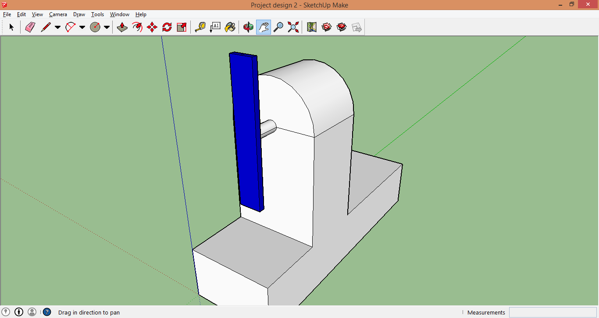
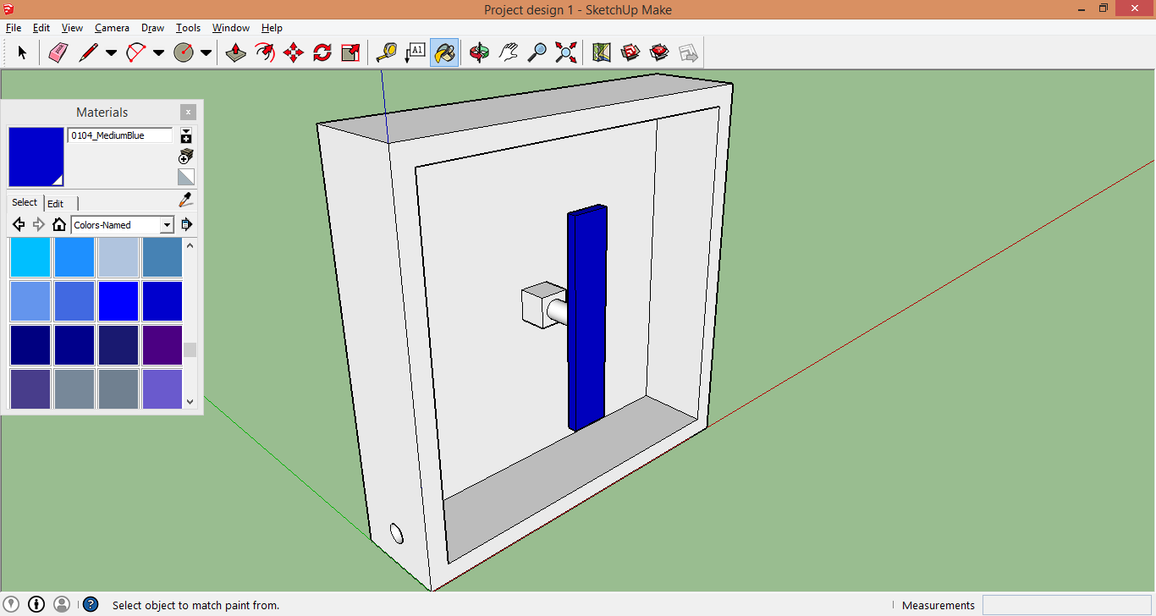
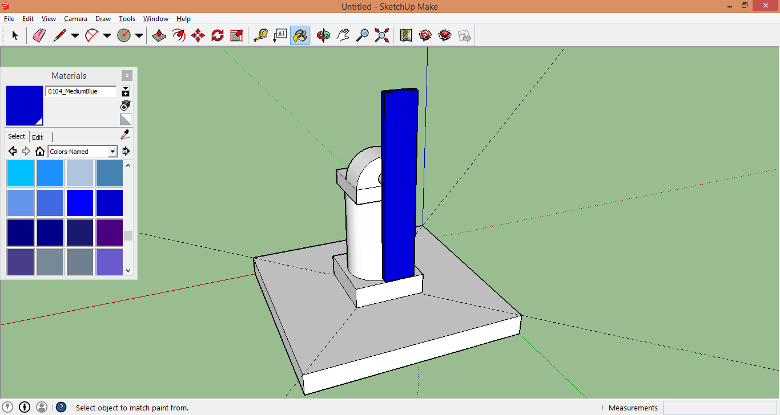
Concept ideas

Slide 8
Thank you for listening

